Slide 1
UI Specification Prototype Presentation
Config Ref: SE.G02.UISpec
Authors: JAB153, WIA14, TPR3

Slide 2
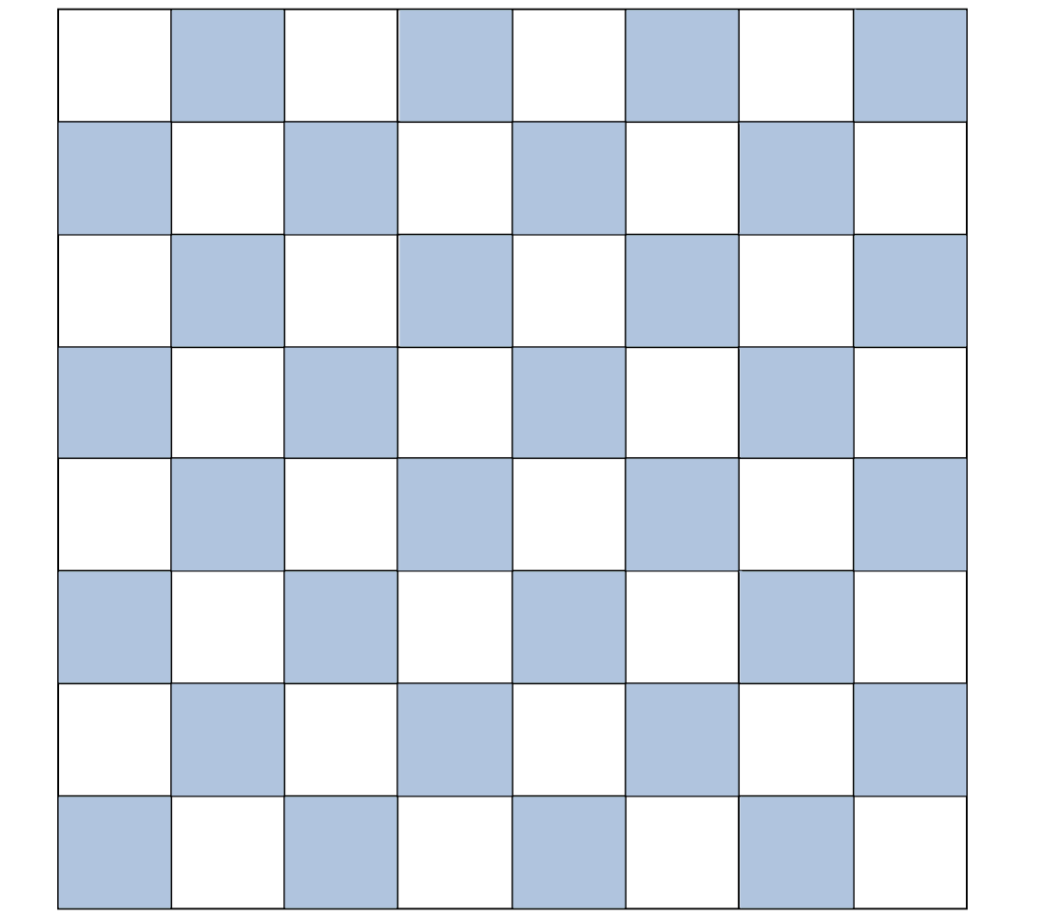

UC01 - Start game
Task: Starting a new chess game
Action:
Starting the game leads to the main menu.
Choosing "Start game" creates a new game and allows the user to select their colors.
Choosing "Load game" opens the file explorer to access previously saved games.
Choosing "Replay game" opens the file explorer to access previously completed and saved games.
Choosing "Quit game" exits the application.
Result: The main menu provides options to start a new game, load a saved game, replay a completed game, or quit the application. The user can also choose their preferred colors before starting a new game.
Start Game
Load Game
Replay Game
Quit Game

Slide 3

UC01 - Start game
Brings up menu for the user to enter player names and select colour with a check box, changing one check box automatically changes the other check box.
Start will begin the game with the selected settings.
UC04 - Back button
The back button will allow the user to go back to the previous menu.
Player 1:
Mohammed
Player 2:
Mary
White
Black
Start
Back

Slide 4
UC02 - Load game
Task: Loading a chess game save.
Action:
Upon selecting "Load game," a file explorer is launched.
The user can search for previously saved games that were left unfinished.
After selecting a save game, the game board is set to the state it was saved in.
The user can continue playing the game from the saved state.
Result: The "Load game" feature allows the user to retrieve and resume previously saved games. By launching a file explorer, the user can select the desired saved game and load it into the game application. This restores the game board to the saved state, allowing the user to continue playing from where they left off.
Start Game
Load Game
Replay Game
Quit Game

Slide 5
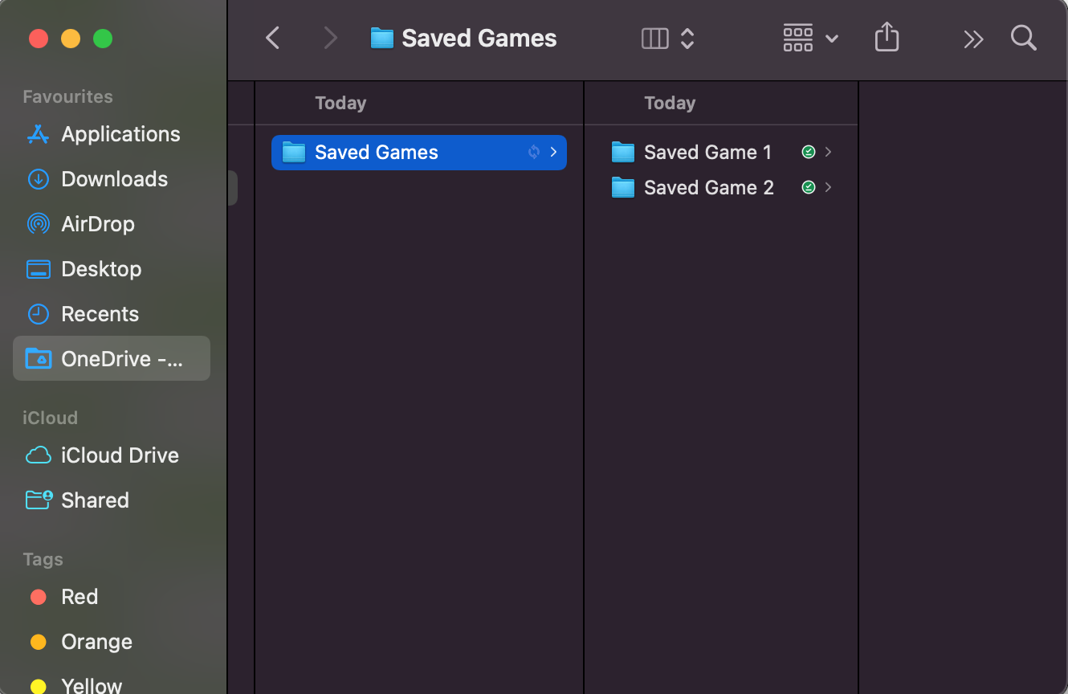
UC02 - Load game
Task: Player needs to load an old game
Action:
Player will select load game from the menu
Player will search for their saved game
Player will be taken to the game screen with all the pieces loaded into their correct spaces
Result:
After user selects load game, a file browser is popped up with the user able to choose a save game.
After opening the save file, the board is set to the state it was saved in and the user can carry on playing the game.
New Game
Load Game
Quit Game

Slide 6
UC03 - Replay game
Task: Loading a replay and navigating a previous game
Action:
The player will click the replay button, which will lead to the file explorer being launched.
The player will then select a replay which will display
Result: The player will then be able to navigate, step by step through a previous game to see exactly how it was played.
Start Game
Load Game
Replay Game
Quit Game

Slide 7
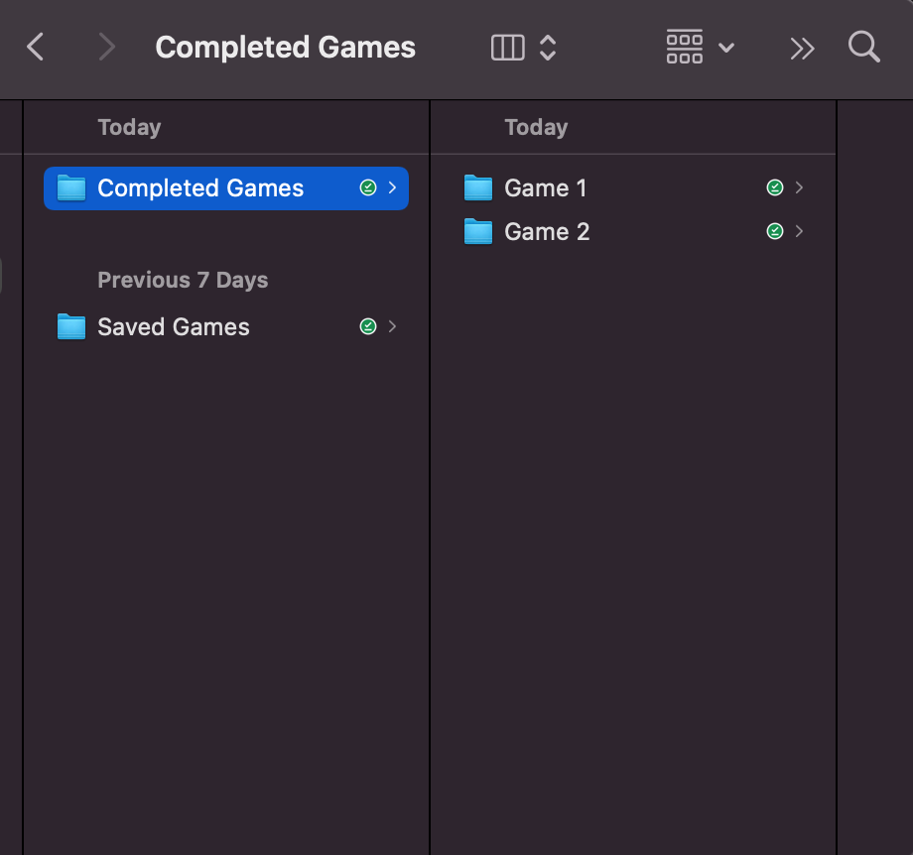
UC03 - Replay game
A file explorer is launched so the user can navigate to a previously completed game and load it to replay a previous game.
After the user finds the desired saved game, the pieces are loaded onto the board.
New Game
Load Game
Replay Game
Quit Game

Slide 8












Mohammed's Turn
UC03 - Replay game
The board is loaded from the starting point with arrows to indicate back and forward moves that allow the user to progress through the game.
If the user selects the forward arrow, the first move in that game is shown.
Quit

Slide 9
Mary's Turn
UC03 - Replay game
After each click of either the forward or back arrow the moves are shown, and the user can play all the way through the saved game. Any captured pieces are also shown in the trays at either side of the board.
At any point the user can quit back to the main menu.
Quit

Slide 10
UC05 - Quit
On the main menu, if the user quits the game, there is another menu to confirm the quit which will completely close the application down.
Start Game
Load Game
Replay Game
Quit Game

Slide 11
UC05 - Quit
If the user quits the game, there is another menu to confirm the quit.
Yes, quits the game.
No, takes the user back to the menu.
Are you sure you would like to quit?
Yes
No

Slide 12
Mohammed's Turn
UC05 - Quit
At any point, either user can select to quit the game and go back to the main menu.
After selecting quit the user is prompted with are you sure you want to quit in case of a miss click.
Draw
Save
Resign
Quit
x1
x1
x4
x1

Slide 13
Mohammed's Turn
UC06 - Select piece
UC09 - See all potential moves for selected piece
User selects piece with a single left click to play. This displays all potential moves for this piece with dots.
The user will then left click again on the cell they would like to move the selected piece to.
The user's turn is depicted in the top right of the board.
Draw
Save
Resign
Quit

Slide 14
Mary's Turn
UC06 - Select piece
UC07 - Move piece
UC09 - See all potential moves for selected piece
Once the user has selected the desired cell, the piece is moved to that position and the play switches to the opposing user.
This is indicated by the user’s turn changing in the top right.
Draw
Save
Resign
Quit

Slide 15
Mohammed's Turn
UC08 - Capture piece
As in UC10, after the user has left clicked on a piece to select it, the potential moves for that piece.
If an opponent's piece can be captured, the piece is highlighted with a circle.
Draw
Save
Resign
Quit

Slide 16
Mary's Turn
UC08 - Capture piece
UC11 - See all removed pieces
If the user wants to capture the opponent's piece, they left click on the piece, and it is removed form the board.
After a piece has been captured, it is placed on the side tray with other discarded pieces. Play changes to the opposing user.
Draw
Save
Resign
Quit
x1

Slide 17
Mohammed's Turn
UC10 - Promoting a pawn
The user has got into a position to promote their pawn by placing it on the back row of the opposing user. They then have the option to choose a piece to promote to, these are indicated at the top by the four pieces.
Draw
Save
Resign
Quit
x1
x1
x4

Slide 18
Mohammed's Turn
UC10 - Promoting a pawn
The user left clicks on the piece they would like to promote to, and the pawn is replaced with that piece on the playing board. The pawn is placed into the captured piece tray of their respective colour.
Draw
Save
Resign
Quit
x1
x1
x4

Slide 19

Mohammed's Turn
UC12 - Prompt Castling move
If castling is available, the user will be prompted when left clicking and selecting the king.
It is shown with two gold colour pieces in the final positions after castling.
Draw
Save
Resign
Quit
x1
x1
x4
x1

Slide 20
Mary's Turn
UC13 - Prompt En passant
If the user selects a pawn and
en passant is available, this is shown with a circle around the piece being captured. With a yellow pawn indicating where the piece will end up after taking the opponents pawn circled in yellow.
The usual grey dot is shown if the user would like to advance in the normal way.
Draw
Save
Resign
Quit
x1
x1
x4
x1

Slide 21
Mary's Turn
UC14 - Check
Task: Put king in check
Action:
When a king is placed into check by the opposing user, the cell underneath the king will turn yellow.
If the user selects the king to move, the dots shown will only show valid moves to get the user of out check.
If other pieces can be moved to get the king out of check then when a piece is selected the moves are shown.
If a user selects a piece that cannot protect the king, its potential moves will not be shown.
Result:
The player should only be able to move the king out of check. If the player tries to perform another action, then the game will display a prompt letting them know they are in check and need to get their king out of check.
Draw
Save
Resign
Quit
x1

Slide 22
Mary's Turn
UC14 - Check
If other pieces can be moved to get the king out of check, then when a piece is selected only the moves that get the king out of check are shown.
If a user selects a piece that does not allow the king to get out of check, no moves are shown, and the user cannot move that piece.
Draw
Save
Resign
Quit
x1

Slide 23
Mohammed's Turn
UC15 - Checkmate
UC19 - End game
When checkmate is played the game ends, and the cell the king is in is highlighted red.
It allows the user to save the replay if they would like to replay it later.
Save replay brings up the file explorer to allow the user to save to a desired location.
Quit game will take the user back to the main menu.
Draw
Save
Resign
Quit
Checkmate! Mohammed wins
Save Replay
x1
Quit Game

Slide 24
Mohammed's Turn
UC16 - Save game
If the user would like to save the game to resume later, they can click save game which brings up a file explorer to select the location.
The user then saves the game in the desired location and can quit the game or carry on playing.
Draw
Save
Resign
Quit
x1
x1
x4
x1

Slide 25
Mary's Turn
UC17 - Offer draw
UC19 - End game
On either users turn; they have the option to declare if they would like to call for a draw and end the game.
If one user selects to draw this prompts the other user.
Draw
Save
Resign
Quit
x1
x1
x4
x1

Slide 26
Mary's Turn
UC18 - Resign button
The prompt is shown to determine if the user would like to accept or decline the draw.
If accepted this will prompt the end game menu where the user can select to save the game to replay later.
If declined, the game will continue.
Draw
Save
Resign
Quit
Mary has offered a draw. Mohammed, do you Accept?
Accept
x1
Decline
x1
x4
x1

Slide 27
Mary's Turn
UC18 - Resign button
UC19 - End game
Whosever turn it is, they have the option to resign the game. By clicking on resign they are prompted with an are you sure message in case of a miss click.
Yes, will lead to the next prompt (next slide).
No, will allow the game to continue.
Draw
Save
Resign
Quit
Mary, are you sure you want to resign?
Yes
x1
No
x1
x4
x1

Slide 28
Mary's Turn
UC18 - Resign button
UC19 - End game
After yes has been selected, there is the option to save the replay or quit.
Saving the replay will save the game file with other completed games for replaying the match later with opening up the file explorer.
Quit will take the user back to the main menu
Draw
Save
Resign
Quit
Mohammed wins! Mary has resigned
Save Replay
x1
Quit Game
x1
x4
x1

Slide 29
Mary's Turn
EC02 - Move piece
Task: Select enemy piece
Action:
The white player will attempt to select the black player’s piece
Result:
The game will display a popup explaining to the player that they cannot select their opponent's piece, as well as reminding them of which player they are.
Draw
Save
Resign
Quit
You cannot select you opponent’s piece, your pieces are white at the bottom on the screen.
Okay
x1
x1
x4
x1

Slide 30
Mary's Turn
EC09 - Check
Task: Attempt to move a piece that cannot protect the king
Action:
The player will try to select a piece that cannot help the king
Result:
The game will display a popup explaining to the player that they must protect their king, either by moving the king or another piece that can block the attack.
Draw
Save
Resign
Quit
Your king is in check! You must either move your king out of danger or block the danger using a piece that can.
Okay
x1

